Slide 1

Menus and Settings
CIS 399

Slide 2
Course Overview
Wk | Topic
1 | Intro, single-screen apps
1 | Activity Lifecycle, saving activity state
2 | Layouts + widgets, Event Handlers
2 | Themes + styles, Menu + settings
2 | Multi-screen apps, Fragments
Wk | Topic
3 | Reading XML files, Asynch Tasks
3 | List Views
3 | SQLite Database
4 | Consuming a web service
4 | Geolocation

Slide 3

Menus

Slide 4
Types of Menus
Options menu and app bar
The primary collection of menu items for an activity. It's the place for actions that affect the entire app
Context menu and contextual action mode
A context menu is a floating menu that appears when the user performs a long-click on an element
Contextual action mode displays action items that affect the selected content in a bar at the top of the screen
Popup menu
Displays a list of items in a vertical list that's anchored to the view that invoked the menu
Notes:
https://developer.android.com/guide/topics/ui/menus.html
In this presentation, we will only look at the first type, the options menu

Slide 5
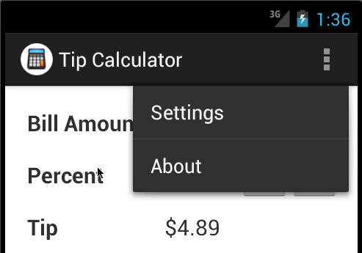
Options Menu
Options menu displayed from an action overflow icon
Murach's Android Programming, C8
© 2015, Mike Murach & Associates, Inc. – modified by Brian Bird 2016
Slide 5

Slide 6
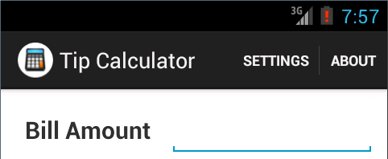
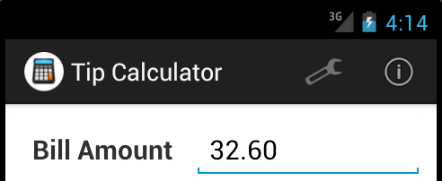

Slide 7
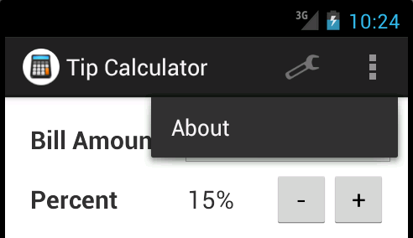

Slide 8
Exercise
Open ch08_ex1_TipCalcualtor and run it
Click on the action bar overflow icon and on each of the menu items.

Slide 9
Note: This XML file format is used for all menu types
Notes:
https://developer.android.com/guide/topics/ui/menus.html#xml

Slide 10
Elements in a Menu XML file
<menu>
Defines a Menu, which is a container for menu items.
Must be the root node for the file
Can hold one or more <item> and <group> elements.
<item>
Creates a MenuItem, which represents a single menu item
May contain a nested <menu> element for a submenu
<group>
An optional, invisible container for <item> elements.
Allows you to categorize menu items so they share properties such as active state and visibility.

Slide 11
Attributes of the Menu Item
Commonly used attributes of the <item> element:
android:id
A resource ID that's unique to the item, which allows the application to recognize the item when the user selects it
android:icon
A reference to a drawable to use as the item's icon
android:title
A reference to a string to use as the item's title
android:showAsAction
Specifies when and how this item should appear as an action item in the app bar; values: always, never, ifRoom
android:orderInCategory
Specifies an int value for the sequence of the item in ascending order

Slide 13
Exercise
Open ch08_ex1_TipCalcualtor
Modify the XML file so that both the Settings item icon and About item icon are displayed on the action bar.

Slide 16

Starting Another Activity

Slide 17
Context
An interface to global information about an application environment. This is an abstract class whose implementation is provided by the Android system. It allows access to application-specific resources and classes, as well as up-calls for application-level operations such as launching activities, broadcasting and receiving intents, etc.
From: https://developer.android.com/reference/android/content/Context.html

Slide 19
Add the Activity to the Manifest
Each Activity must be listed in the manifest:
<application> <!-- Attributes removed for clarity --> <activity android:name="com.murach.tipcalculator.TipCalculatorActivity" android:label="@string/title_activity_tip_calculator" > <intent-filter> <action android:name="android.intent.action.MAIN" /> <category android:name="android.intent.category.LAUNCHER" /> </intent-filter> </activity> <activity android:name="com.murach.tipcalculator.SettingsActivity" android:label="@string/title_activity_settings" > </activity> <activity android:name="com.murach.tipcalculator.AboutActivity" android:label="@string/title_activity_about" android:theme="@style/DialogTheme"> </activity> </application>

Slide 20
Exercise
Open the ch08_ex1_TipCalculator project
Put a breakpoint in onCreateOptionMenu and run the app in debug mode
Put breakpoints in each of the callback methods below and then run the app in debug mode
onOptionsItemSelected
AboutActivity, onCreate
SettingsActivity, onCreate
For each of the methods below, how might the code change in a different app?
onCreateOptionMenu
onOptionsItemSelected

Slide 21
Textbook Exercise
Do Exercise 8-2, Work with Menus, in the textbook
Use the exercise starter project, ch08_ex2_TipCalcualtor
Add items to the TipCalculatorActivity menu:
Help: just a place-holder for now; shows a toast
Refresh: updates the calculations
Add a menu to the PreferencesActivity with items:
Tip Calculator: invokes the TipCalculator activity
About: invokes the About activity

Slide 22

Settings
Notes:
https://developer.android.com/guide/topics/ui/settings.html

Slide 23
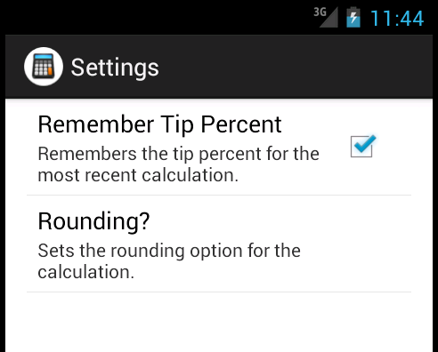
Murach's Android Programming, C8
© 2015, Mike Murach & Associates, Inc.
Slide 23

Slide 24
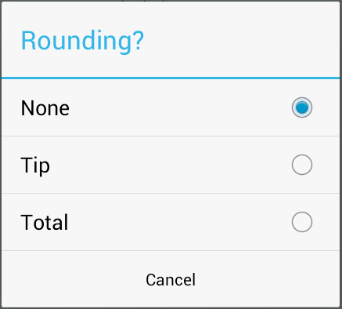
Murach's Android Programming, C8
© 2015, Mike Murach & Associates, Inc.
Slide 24

Slide 25
Notes:
Note that Preference items are used, not View items
https://developer.android.com/guide/topics/ui/settings.html#DefiningPrefs

Slide 26
Murach's Android Programming, C8
© 2015, Mike Murach & Associates, Inc.
Slide 26

Slide 27
Exercise
Open ch08_ex1_TipCalcualtor
Alter the values in the Preference elements’ attributes to see their effect

Slide 28
Murach's Android Programming, C8
© 2015, Mike Murach & Associates, Inc.
Slide 28

Slide 29
Murach's Android Programming, C8
© 2015, Mike Murach & Associates, Inc.
Slide 29

Slide 30
Exercise
Open ch08_ex1_TipCalcualtor
Put breakpoints in onCreate of both the SettingsActivity and the SettingsFragment
Run the app and see when the breakpoints are hit

Slide 31
Murach's Android Programming, C8
© 2015, Mike Murach & Associates, Inc.
Slide 31

Slide 32
Murach's Android Programming, C8
© 2015, Mike Murach & Associates, Inc.
Slide 32

Slide 33
Murach's Android Programming, C8
© 2015, Mike Murach & Associates, Inc.
Slide 33

Slide 34
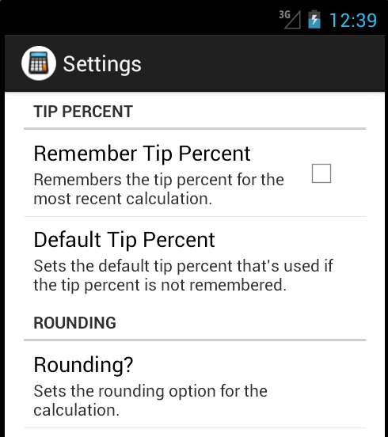
Murach's Android Programming, C8
© 2015, Mike Murach & Associates, Inc.
Slide 34

Slide 35
Murach's Android Programming, C8
© 2015, Mike Murach & Associates, Inc.
Slide 35

Slide 36
Textbook Exercise
Do Exercise 8-3, Work with Preferences, in the textbook
Use the exercise starter project, ch08_ex3_TipCalcualtor
Add a ListPreference with three default tip amounts to the menu
Add categories:
Tip Percent
Rounding
In the SettingsFragment, disable Default Tip Percent when Remember Tip Percent is unchecked

